Slide 1



HR Strategy
View in Power BI
Last data refresh:
12/10/2023 11:20:47 AM UTC
Downloaded at:
1/2/2024 3:28:33 PM UTC

Slide 2
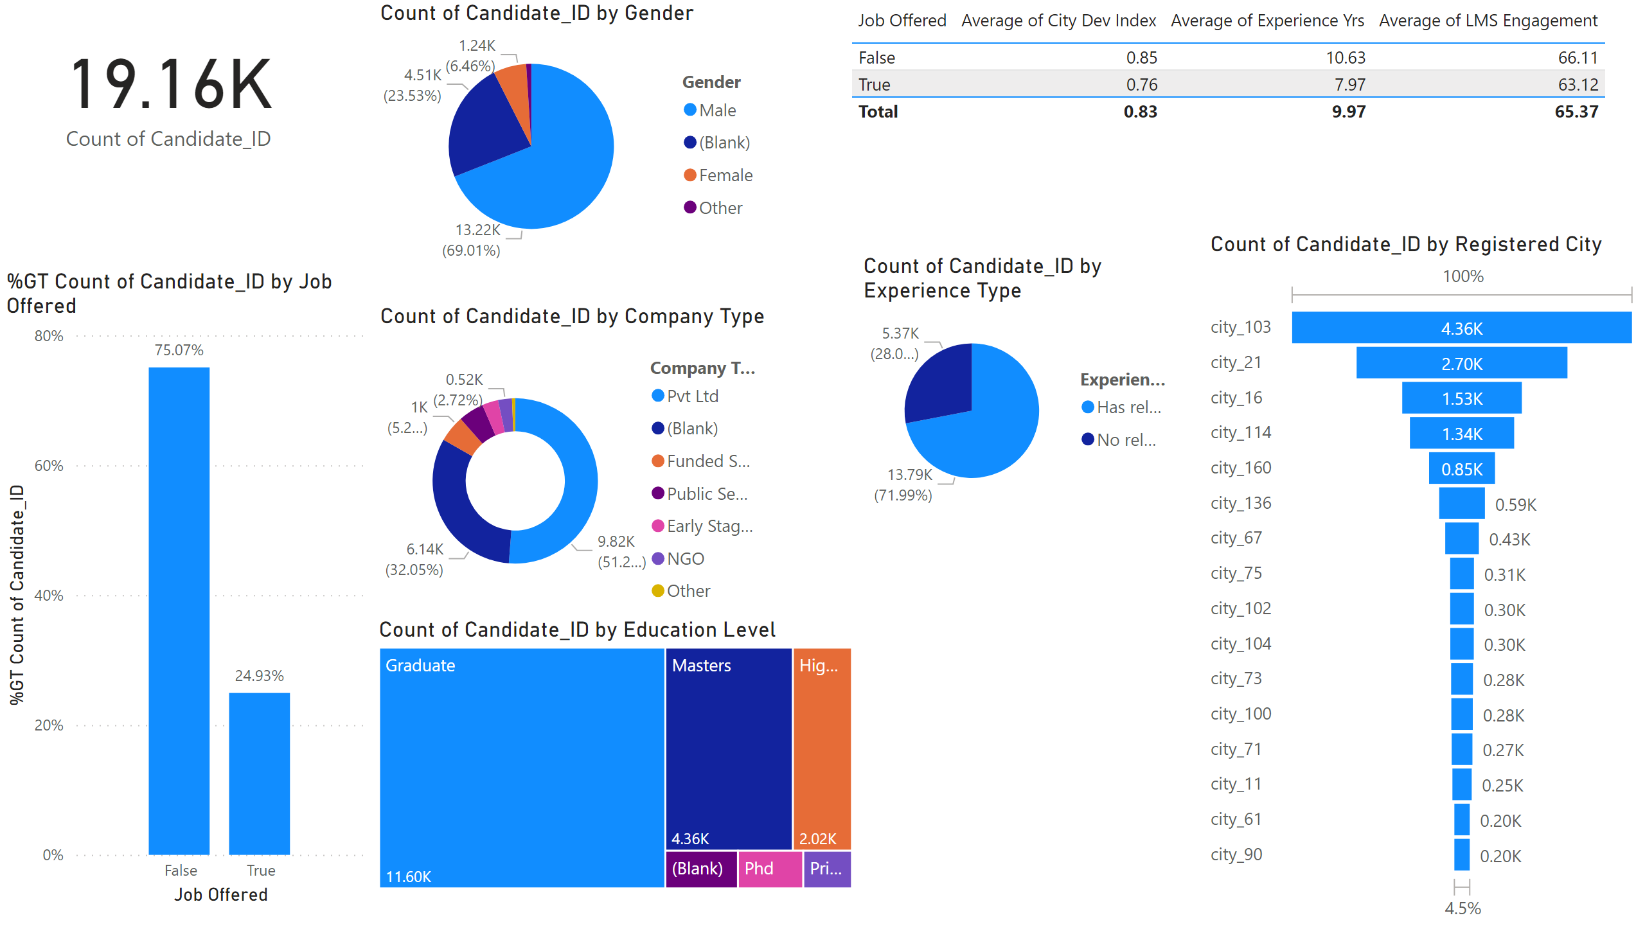
Page 1
Notes:
card
No alt text provided
columnChart
No alt text provided
pieChart
No alt text provided
donutChart
No alt text provided
treemap
No alt text provided
tableEx
No alt text provided
pieChart
No alt text provided
funnel
No alt text provided

Slide 3
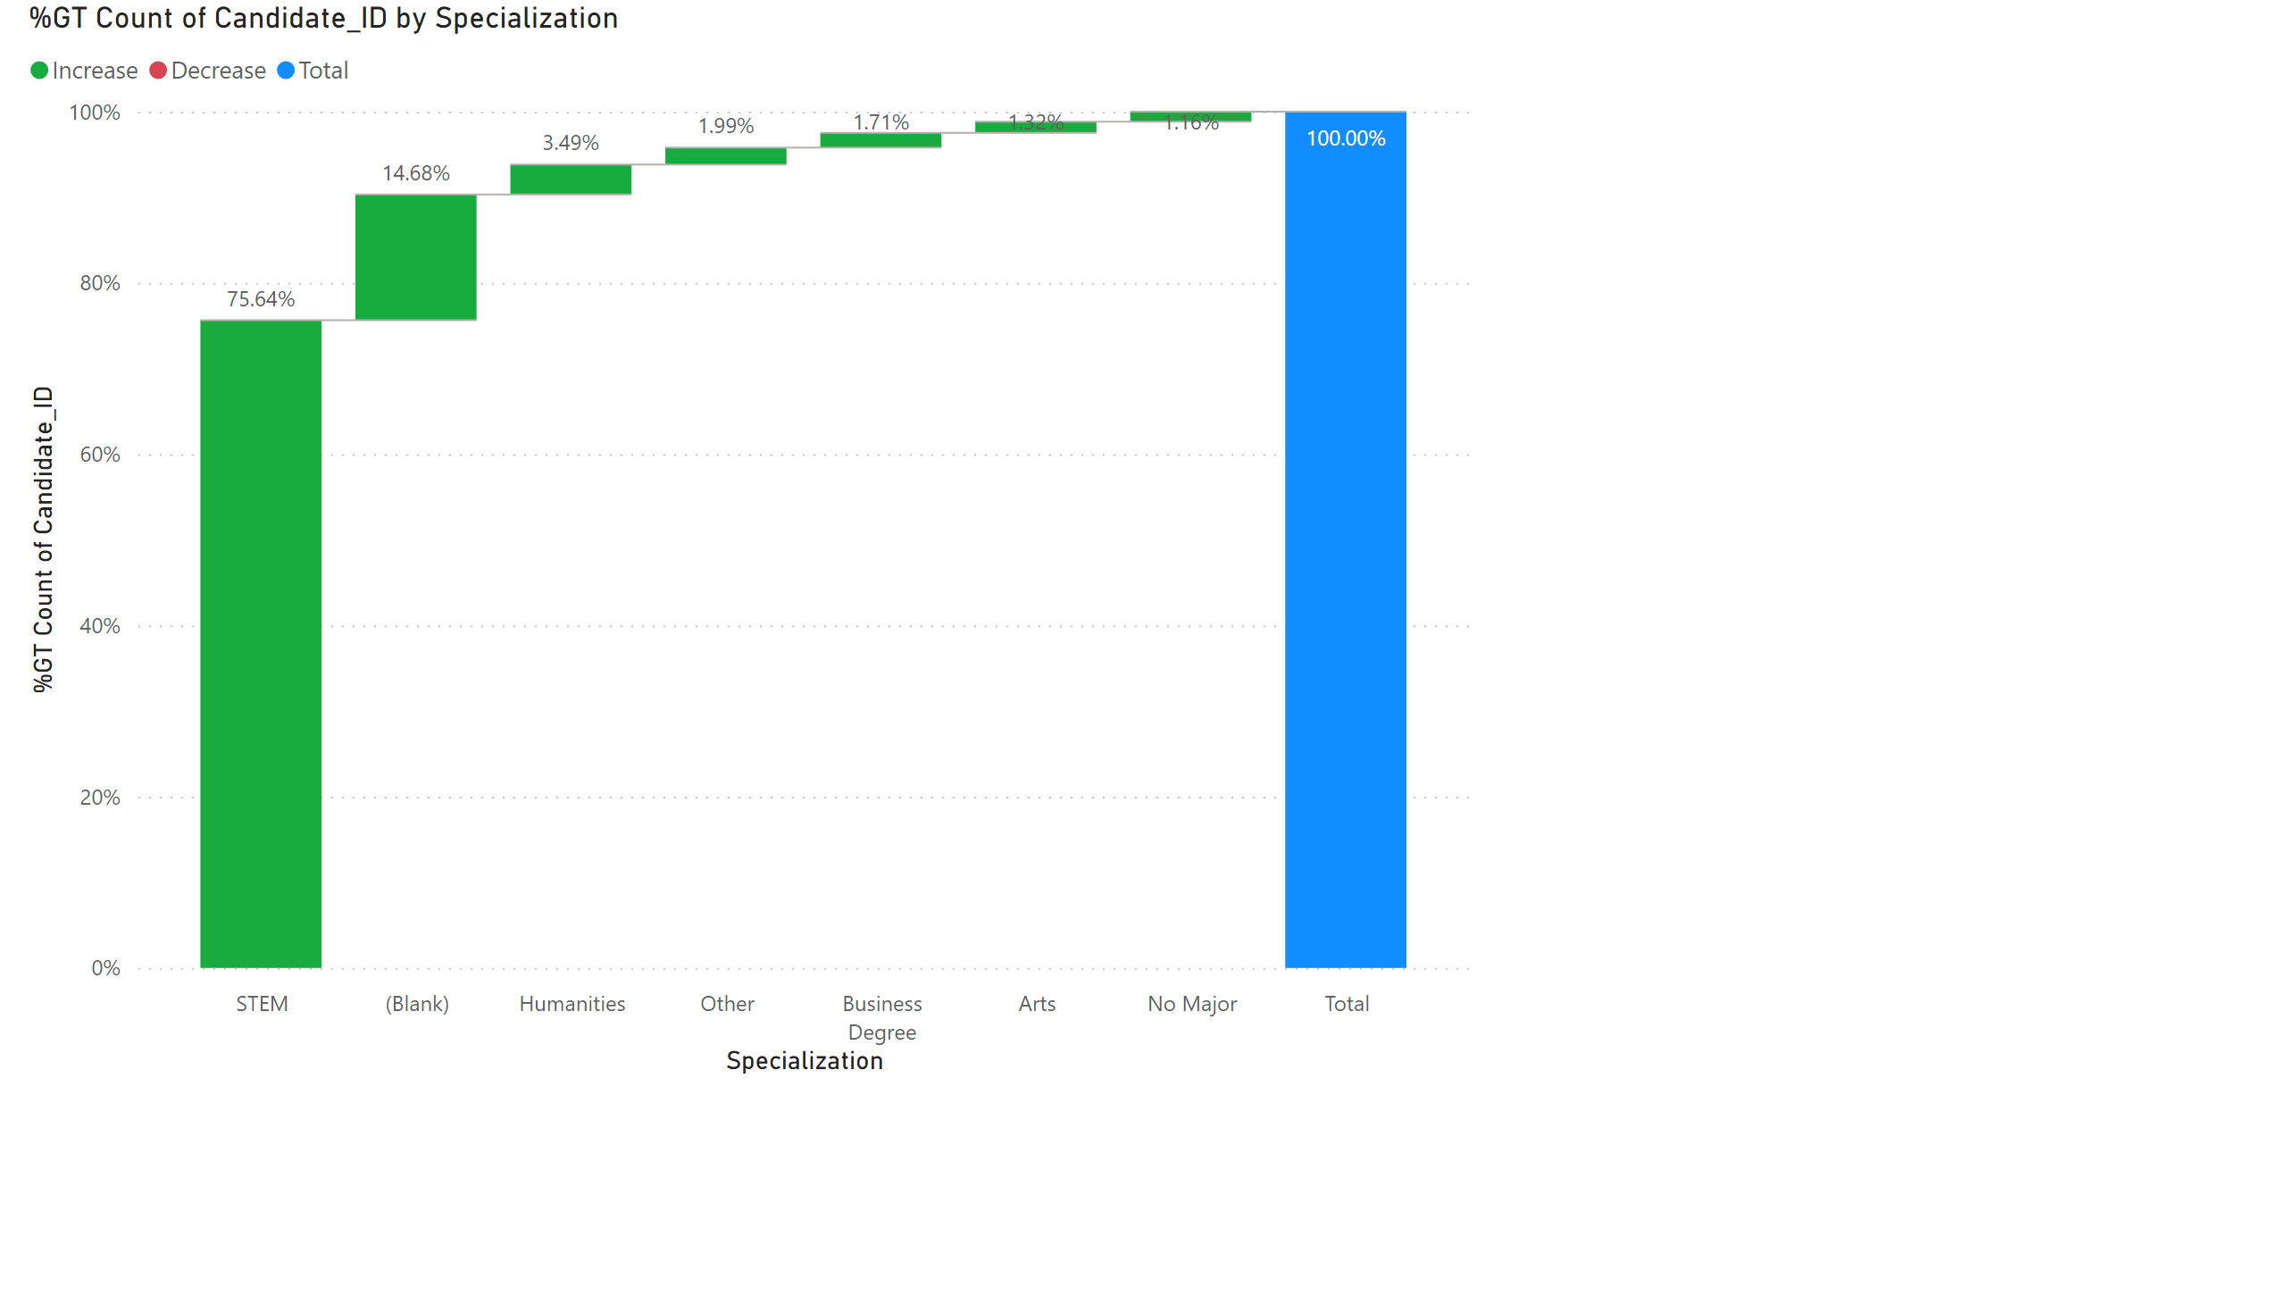
Page 2
Notes:
waterfallChart
No alt text provided

Slide 4
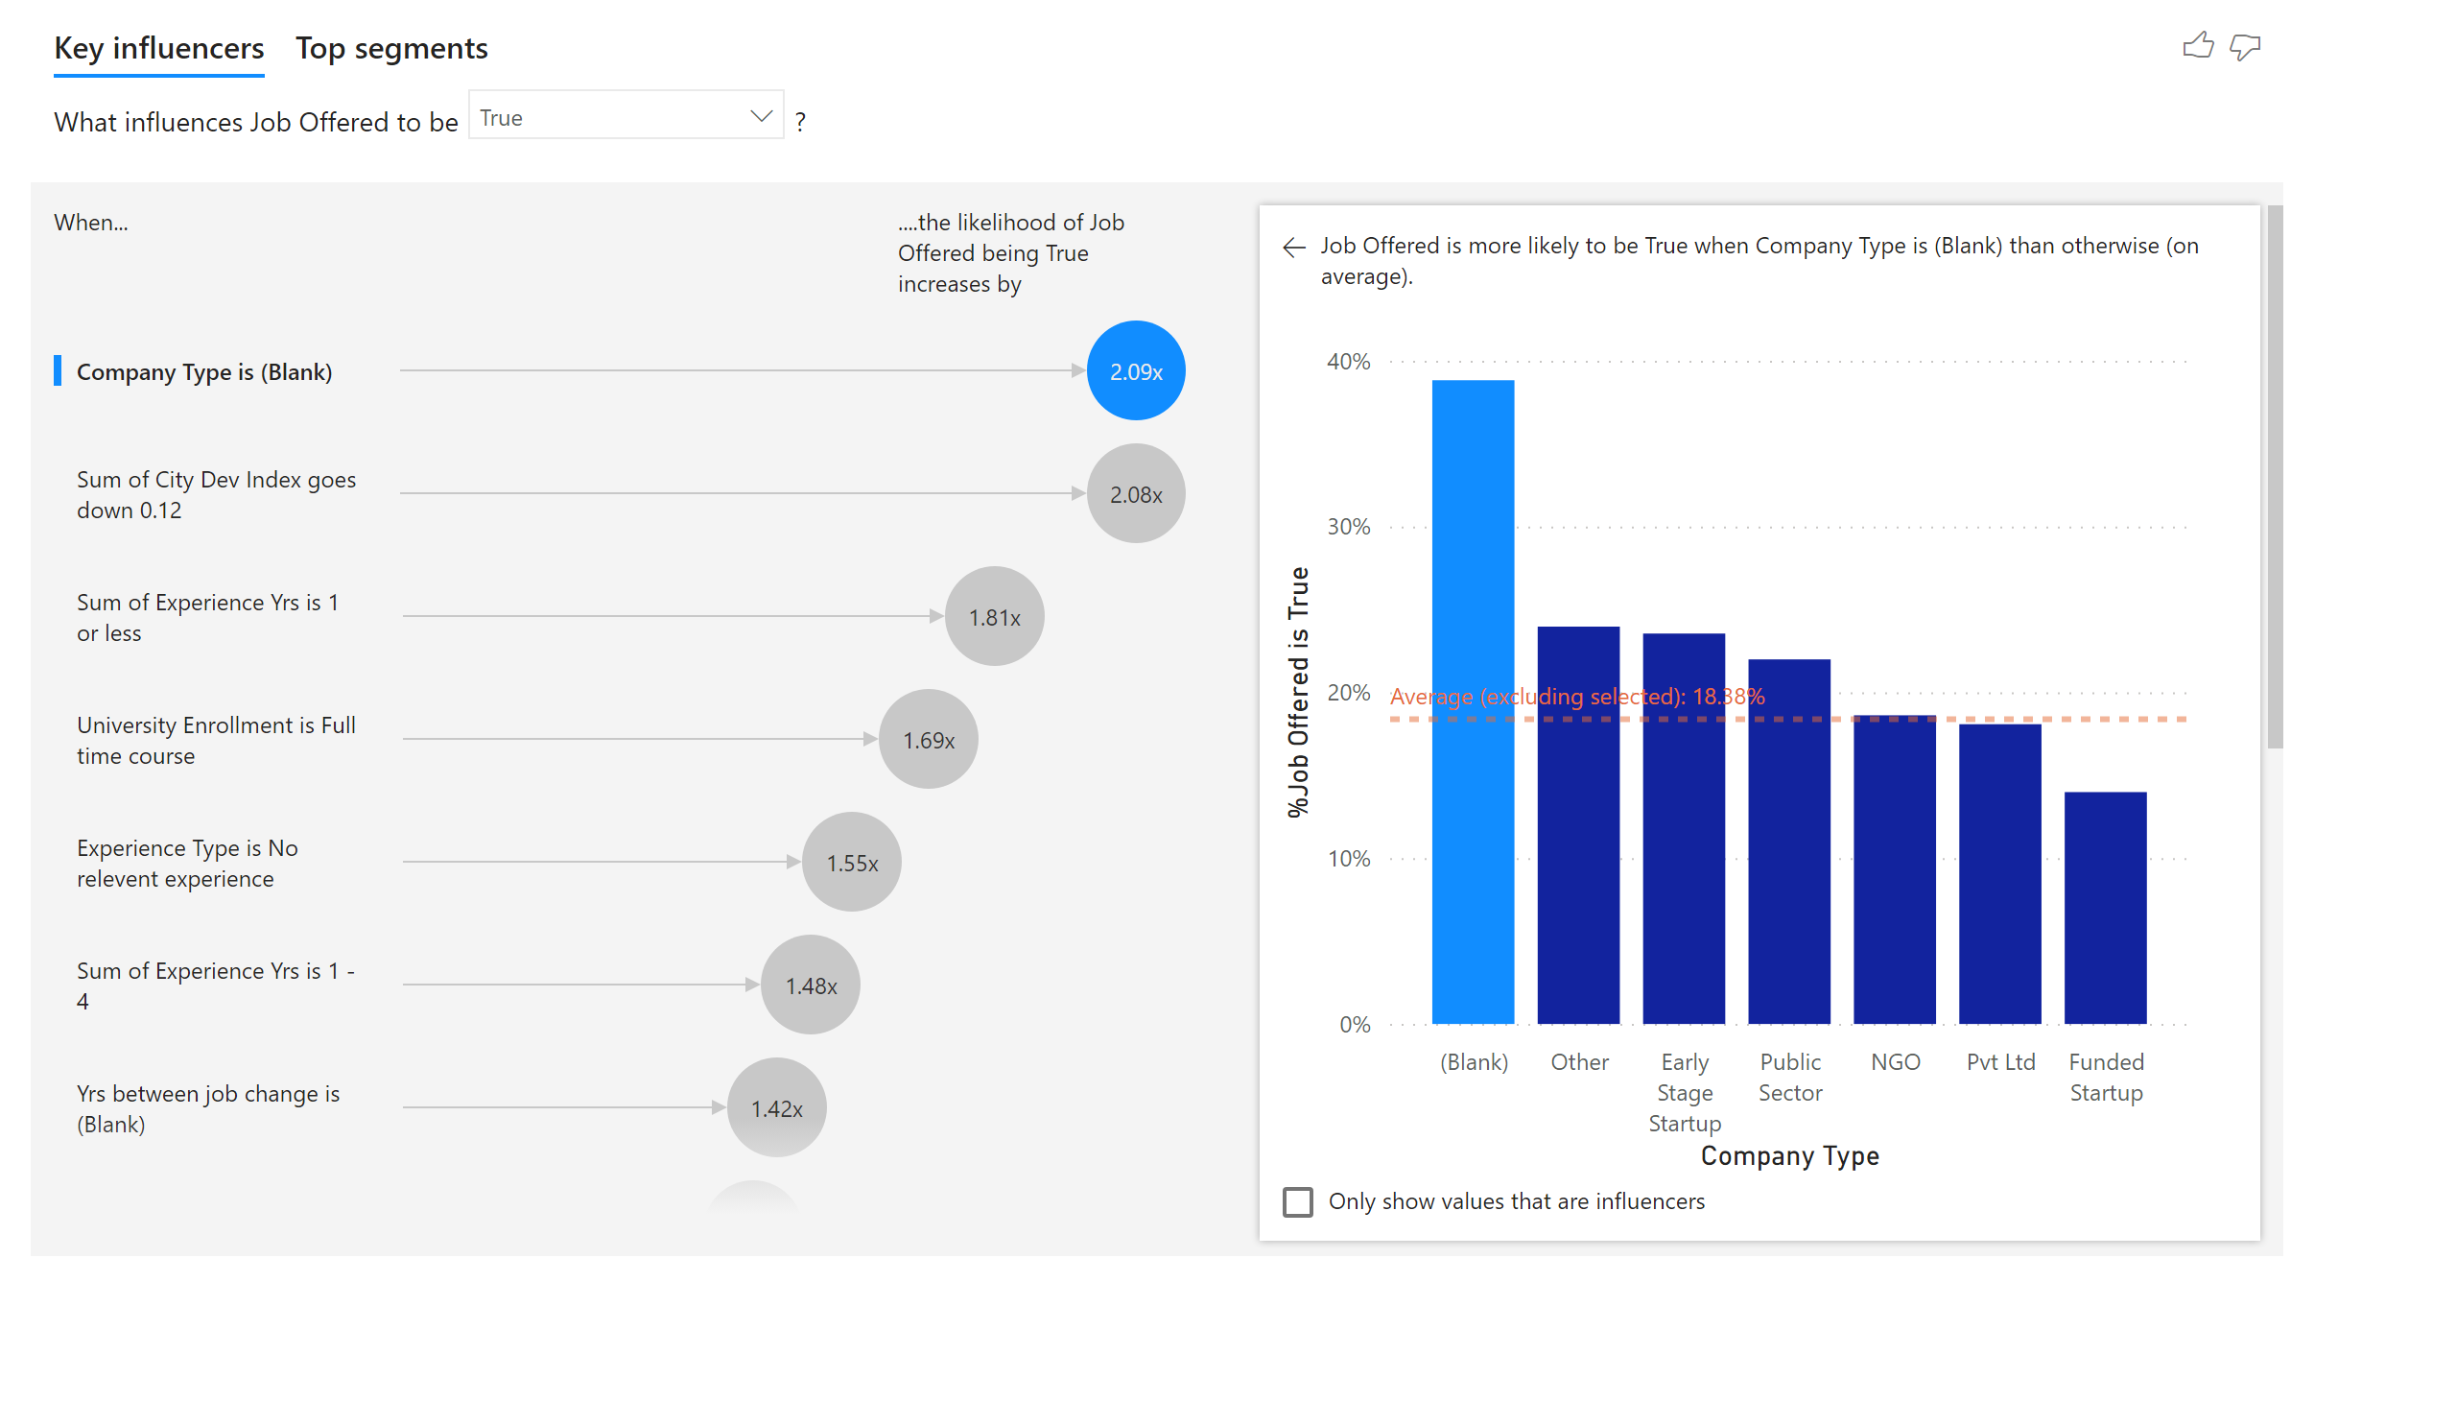
Page 3
Notes:
keyDriversVisual
No alt text provided

Slide 5

Page 4
Notes:
decompositionTreeVisual
No alt text provided

